Slide 1
About Single Sign On (SSO)
For Public School District Personnel
Updated: 3/10/15

Slide 2
What is SSO?
SSO is a project by the FDOE designed to make it easier for teachers and school administrators to log into a selection of state resources.
One web address www.fldoe.org/sso
One username and password
Access to state resources are based on account authorizations (i.e. permissions)

Slide 3
What state resources are included in SSO?
For Public School Districts
CPALMS
eIPEP
English Language Arts (ELA) Formative
Florida School Leaders (FSL)
Item Bank and Test Platform (IBTP)
Progress Monitoring and Reporting Network (PMRN)
More resources continue to be added!

Slide 4
How does SSO work?
School districts provide contact information: Functional Lead, Technical Lead, and local helpdesk
School districts choose an authentication method: Hosted or Federated
School districts provide user provisioning information: Identity (who) and Authorization (permission for resources)
School districts provide on-going support for solution

Slide 5
1. Contact Information
Each school district has:
Functional Lead – to coordinate communications and policies related to SSO accounts
Technical Lead – to maintain accuracy of SSO accounts and connectivity
Local Helpdesk – to provide assistance with SSO accounts by handling requests for new accounts and authorizations for resources
Local helpdesk information and state service center information is published on the Support page

Slide 6
2. Authentication Method
Each school district chooses how staff sign into SSO:
Hosted = the username is assigned by FDOE; the password expires every 90 days
Example: 98-jane.doe@fldoe.org
Federated = the username is provided by the school district; the password follows local policy rules
Over 90% of school district staff sign into SSO with federated accounts

Slide 7
3. User Provisioning Information
Each school district provides user provisioning information:
Identity info (who) and authorization info (permissions for resources) by file or online data entry.
Identity
(who)
Authorization
(permission for resources)
User Provisioning Information

Slide 8
4. On-going Support
Each school district provides on-going support by:
Maintaining accurate and up-to-date user provisioning information (identity and authorization)
Attending training/information sessions hosted by FDOE
Informing local helpdesk staff about policies and procedures related to SSO

Slide 9
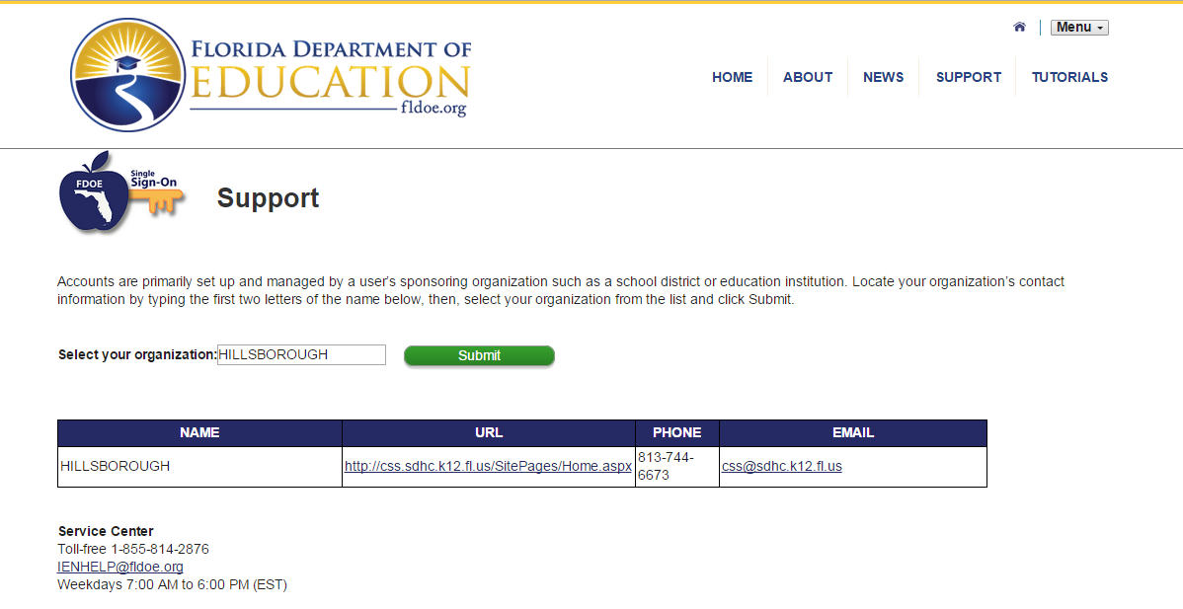
Who do I contact for help?
Use the Support web page. Look up the local helpdesk or contact the state Service Center for assistance.

Slide 10
Who should have an SSO account?
All public school employees, including charter school staff, DJJ staff, virtual school program staff, and administrative staff should have a professional account created and managed by the school district.
Account and/or authorization requests must be made to the local helpdesk (not the state Service Center).
Education professionals should NOT create their own account. A guest access account that begins with a zero (i.e. 0-jane.doe@mail.com) is not a professional account.

Slide 11
Questions?
Support Page
Look up local helpdesk information
https://portal.fldoesso.org/PORTAL/Sign-on/Resources/Support.aspx
Service Center
ienhelp@fldoe.org
1-855-814-2876
Weekdays 7:00 AM to 6:00 PM (EST)

