Slide 1
Changing your Password
For Educators and Guest Access
Updated: 3/10/15

Slide 2
Changing your Password
The path to changing your account password depends on the authentication method selected by your school district/organization.
Federated
Hosted
Your password is managed by your school district/organization. Look up Support contact info.
Your password is managed in the SSO system. Continue slides for more info.
Notes:
Present Slide.

Slide 3
Hosted Accounts
Hosted account usernames begin with a number. For example: 0-jane.doe@k12.fl.us
New hosted account users are sent 2 emails from svc-fim-service@fldoe.org, one with a username and another with a temporary, computer-generated password.
Passwords expire every 90 days.
Password notifications are sent at 14-days prior to expiration, 2-days prior, and on the day of expiration.

Slide 4
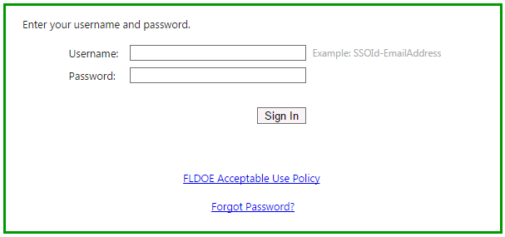
Hosted Accounts
To enable password reset and forgot password functionality, Security Questions must be set up first.

Slide 5
Hosted Accounts
Attempts to change a password or use the forgot password links WITHOUT security questions will result in an error.

Slide 6
Steps for Changing your Password
Sign into your SSO account with the current password
Set up Security Questions
Change your password
If you do not know your username or current password, please contact ienhelp@fldoe.org or call toll-free 1-855-814-2876.

Slide 7
Step One: Sign In
Go to www.fldoe.org/sso and choose the appropriate option for login.
Note – Individuals employed by an educational organization, whether they teach or not, should choose Educators.

Slide 8
Step One: Sign In
Enter your username and current password.
Click Sign In.

Slide 9
Step Two: Security Questions
Under Manage Account, select Security Questions.

Slide 10
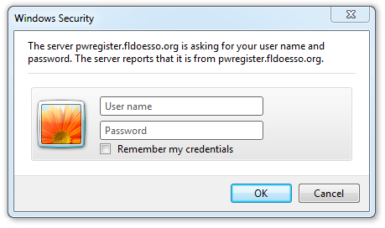
Step Two: Security Questions
Once re-directed to pwregister.fldoesso.org, enter your username and current password.

Slide 11
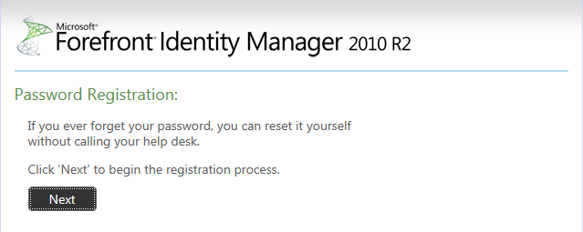
Step Two: Security Questions
Click Next.

Slide 12
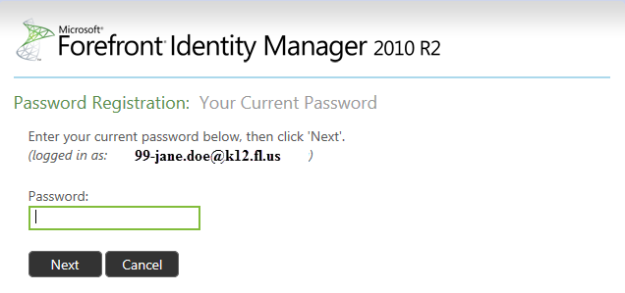
Step Two: Security Questions
Enter the current password.
Click Next.
99-jane.doe@k12.fl.us)

Slide 13
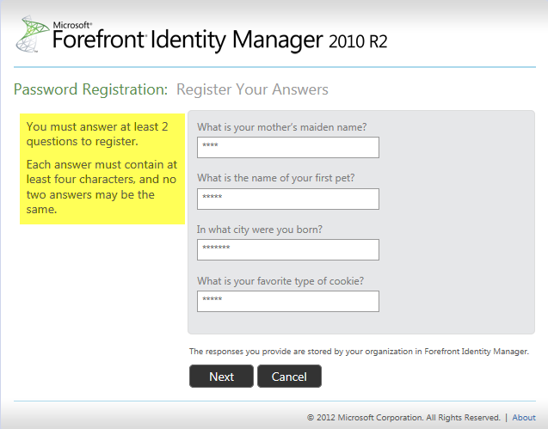
Step Two: Security Questions
Answer Security Questions.
Click Next.

Slide 14
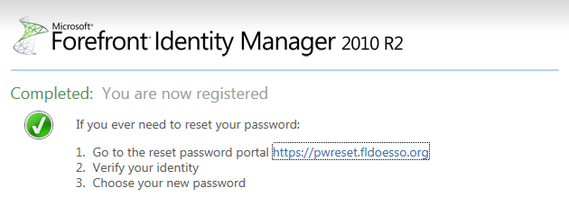
Step Two: Security Questions
Security questions are now complete.
Password Reset and Forgot Password functionality is now enabled.

Slide 15
Step Three: Change Password
Under Manage Account, select Change/Reset Password.

Slide 16
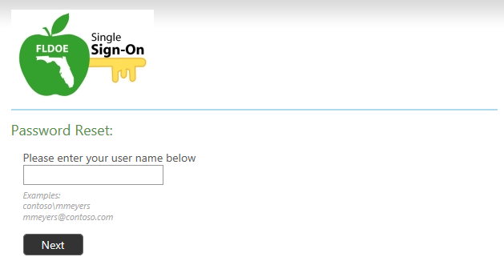
Step Three: Change Password
Once re-directed to pwreset.fldoesso.org, enter your username.
Click Next.

Slide 17
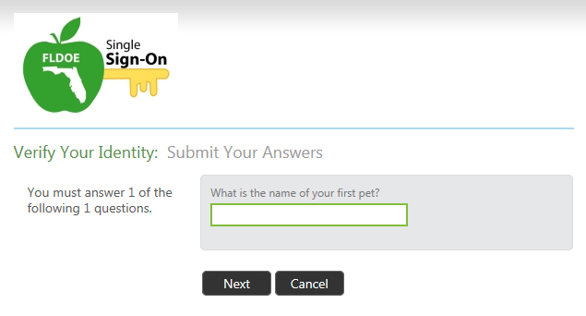
Step Three: Change Password
Provide correct answer to security question.
Click Next.

Slide 18
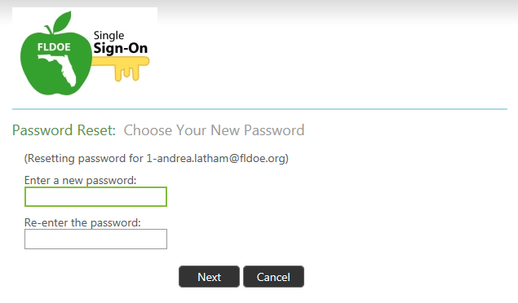
Step Three: Change Password
Enter a new password.
Re-enter the password.
Click Next.
Passwords must be at least 8 characters and contain at least 3 of the 4 character groups:
Uppercase (A-Z)
Lowercase (a-z)
Number (0-9)
Symbol (!@#$%)

Slide 19
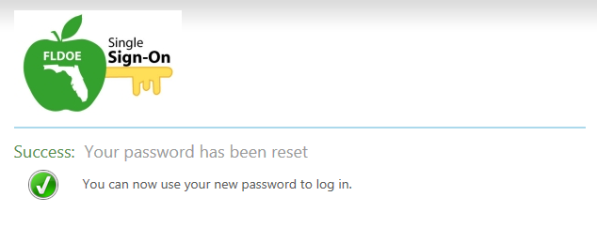
Step Three: Change Password
Change password is now complete.

Slide 20
Questions?
Support Page
Look up local helpdesk information
https://portal.fldoesso.org/PORTAL/Sign-on/Resources/Support.aspx
Service Center
ienhelp@fldoe.org
1-855-814-2876
Weekdays 7:00 AM to 6:00 PM (EST)

