Slide 1
Signing into Single Sign On (SSO)
For Educators and Guest Access
Updated: 3/10/15

Slide 2
Signing into SSO
Your path to logging into SSO depends on the authentication method selected by your school district/organization.
Federated
Hosted
Your login credentials are the same as your local network logon.
Your login credentials are provided by FDOE via email.
Notes:
Present Slide.

Slide 3
GLADESHIGHLANDS
GADSDEN
Federated Districts (48)
Hosted Districts (25)
ALACHUA
BAKER
BRADFORD
BREVARD
BROWARD
CHARLOTTE
CLAY
COLLIER
DADE
DESOTO
DUVAL
ESCAMBIA
FL DEAF/BLIND
FL VS FULL TIME
GADSDEN
GILCHRIST
GLADES
HAMILTON
HARDEE
HIGHLANDS
HILLSBOROUGH
INDIAN RIVER
JACKSON
LAKE
LEE
LEON
LEVY
MANATEE
MARION
OKALOOSA
OKEECHOBEE
ORANGE
OSCEOLA
P.K. YONGE
PALM BEACH
PINELLAS
POLK
PUTNAM
SANTA ROSA
SARASOTA
SEMINOLE
ST. JOHNS
ST. LUCIE
SUWANNEE
UNION
VOLUSIA
WAKULLA
WALTON
BAY
CALHOUN
CITRUS
COLUMBIA
DIXIE
FAMU LAB SCH
FAU LAB SCH
FLAGLER
FRANKLIN
FSU LAB SCH
GULF
HENDRY
HERNANDO
HOLMES
JEFFERSON
LAFAYETTE
LIBERTY
MADISON
MARTIN
MONROE
NASSAU
PASCO
SUMTER
TAYLOR
WASHINGTON
Current as of 3/10/15.
Notes:
Present Slide.
Additional Information:
Hosted
33 Districts
29,849 Users (9%)
Federated
40 Districts
294,952 Users (91%)

Slide 4
Step One
Open an internet web browser

Slide 5
Step Two
Go to www.fldoe.org/sso

Slide 6
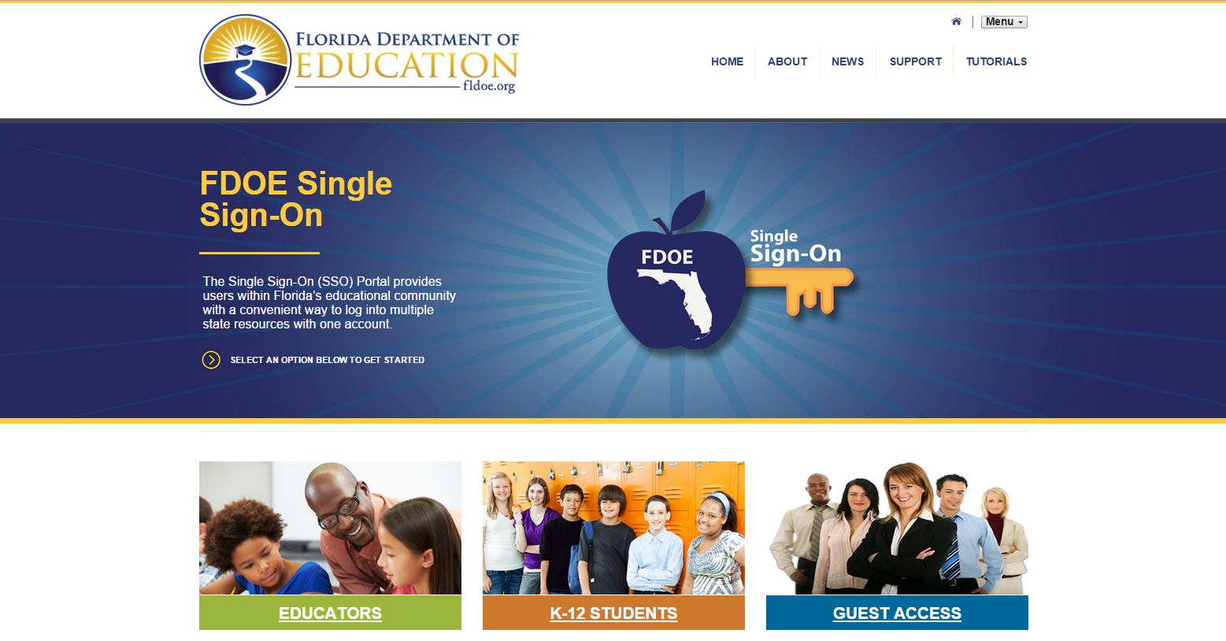
Step Three
Choose the appropriate option for login.
Note – Individuals employed by an educational organization, whether they teach or not, should choose Educators.

Slide 7
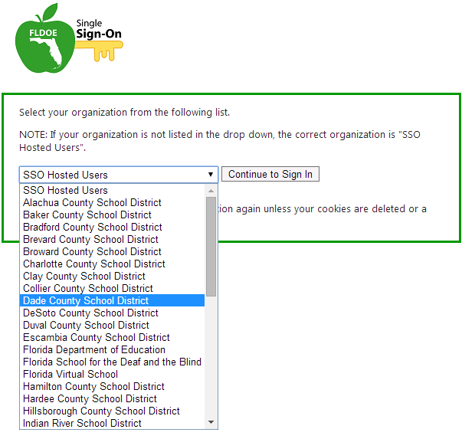
Step Four
When prompted to select an organization, use the drop down list to locate the public school district or organization to which you are a member.

Slide 8
I see my school district.
I don’t see my school district.
School districts specifically listed in the drop down indicates the organization is federated.
Select your school district, and then click Continue to Sign In
Your login credentials are the same as your local network logon.
School districts NOT listed in the drop down indicates the organization is hosted.
Select SSO Hosted Users, and then click Continue to Sign In.
Your login credentials are provided by FDOE via email.

Slide 9
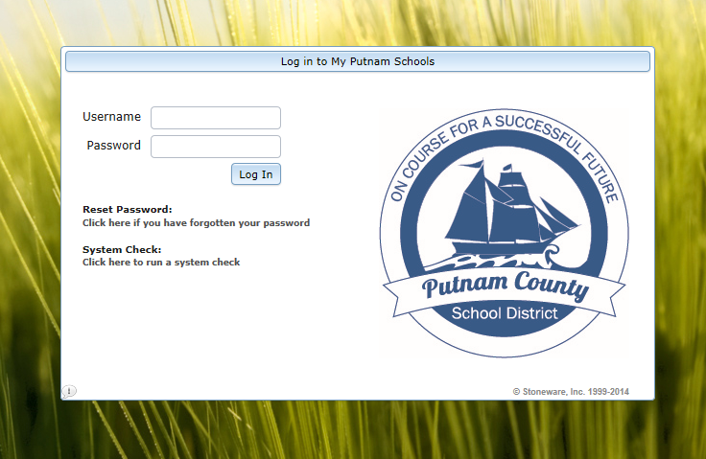
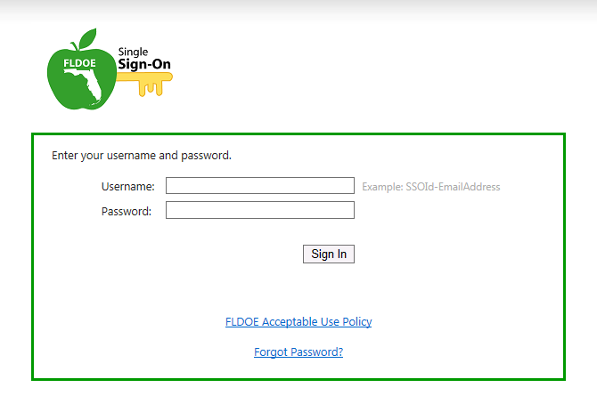
Step Five
Enter the username and password and proceed to log in.
Federated
Hosted

Slide 10
Done! Click on a Resource
The secure SSO page is displayed with your name and authorized resources.

Slide 11
Starting from Scratch
Once the organization is selected, it is stored as a cookie on the computer.
If you ever need to clear it and start the login from scratch, delete your internet browser cookies.
See Deleting Internet Browser Cookies on the Support page for more information.

Slide 12
Questions?
Support Page
Look up local helpdesk information
https://portal.fldoesso.org/PORTAL/Sign-on/Resources/Support.aspx
Service Center
ienhelp@fldoe.org
1-855-814-2876
Weekdays 7:00 AM to 6:00 PM (EST)

